Slide 1

Programming for Engineers
BEP2073
>> Slide 3
>> Object-oriented: variable, types and class
Basic element of object-oriented usage, operational and implementation.

Slide 2

Course Learning Outcome
CLO1 | Outline the operational procedure of programming language.
CLO2 | Outline the object-oriented attribute in the programming flow.
CLO3 | Evaluate the program structure on function, branching and condition.
CLO4 | Develop a programming/syntax solution for chemical engineering case study.
CLO5 | Differentiate between solution error and syntax error for complex engineering case study

Slide 3
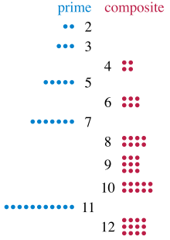
Revision
Write a python program to print all prime numbers between 0 to 100 and print how many prime numbers are there.

Slide 4



Slide 5





Object-oriented: variable, types and class
Objects are the core things that Python programs manipulate.
An object is simply a collection of variables and functions that act on those data.

Slide 6


Revision: Objects & Expressions
programs manipulate data objects
objects have a type that defines the kinds of things programs can do to them
objects are
scalar (cannot be subdivided), ie: int, float, bool...
non-scalar (have internal structure that can be accessed), ie: set,strings...
Try:
Pi = 3.141159
Name = ‘FAUZI’
Fruits = {'Apple’, “Orange”, 'Grape'}

Slide 7




Scalar
Scalar data types: integers, floats, None and bool
int — signed.
float —floating-point numbers.
None —singular null value.
bool — true / false boolean values.

Slide 8

Revision
What volume does 41.2 g of CO₂ gas at a pressure of P atm and a temperature of 514 K occupy?. Given: R = 0.08206 L (atm)/K (mol)
P = 51
V = nRT/P

Slide 9
Non-Scalar
Object have internal structure
For example:
lists : x = [1, 2, 3, 4]; y = [‘a’, ‘b’, ‘c’, ‘d']
tuples : x = (1, 2, 3, 4); y = (‘a’, ‘b’, ‘c’, ‘d’)
strings : x = ‘abcd’
instances of classes.
Note: We can extract parts or components of such values.
Extract
print(type(x))
print(x[1])
for i in x:
print(i)

Slide 10
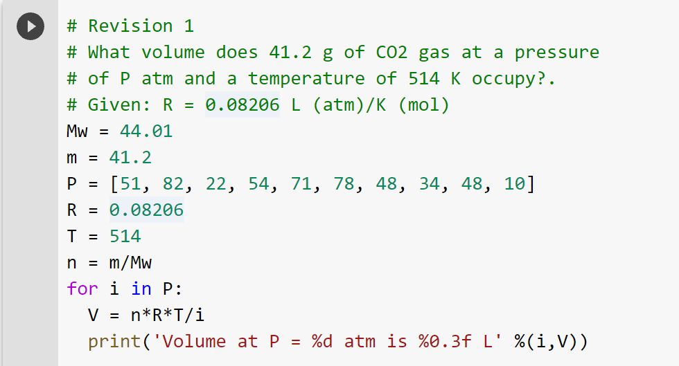
Exercise 1
What volume does 41.2 g of CO₂ gas at a pressure of P atm, and a temperature of 514 K occupy?. Given: R = 0.08206 L (atm)/K (mol)
P = 51, 82, 22, 54, 71, 78, 48, 34, 48, 10
V = nRT/P
Hint: use looping technique

Slide 11
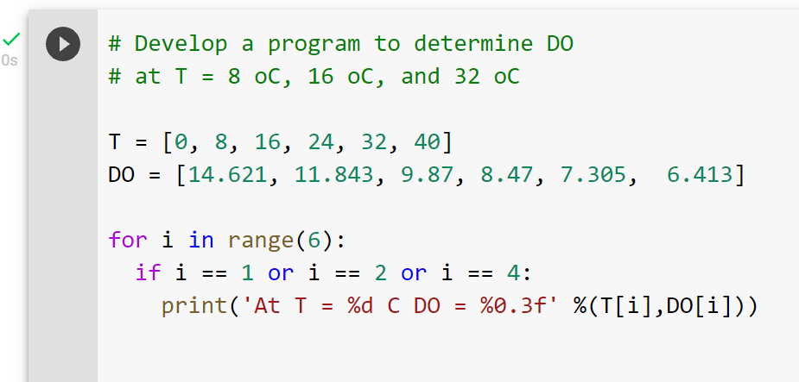
Exercise 2
The following data define the sea-level concentration of dissolved oxygen for fresh water as a function of temperature:
Develop a program to determine DO at T = 8 ºC, 16 ºC, and 32 ºC
Challenge: Compute DO at T = 26 ºC
T ºC | 0 | 8 | 16 | 24 | 32 | 40
DO, mg/L | 14.621 | 11.843 | 9.870 | 8.470 | 7.305 | 6.413

Slide 12
Non-Scalar
Python Collections (Arrays)
List is a collection which is ordered and changeable. Allows duplicate members.
Tuples is a collection which is ordered and unchangeable. Allows duplicate members.
Set is a collection which is unordered and unindexed. No duplicate members.
Dictionary is a collection which is ordered* and changeable. No duplicate members.
Set :
x = {1,2,3,4}
Dictionary :
Car = {
"brand": "Ford",
"model": "Mustang",
"year": 1964
}
print(x['brand'])

Slide 13
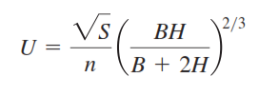
Exercise 3
Manning’s equation can be used to compute the velocity of water in a rectangular open channel,
where U = velocity (m/s), S = channel slope, n = roughness coefficient, B = width (m), and H = depth (m). The following data are available for five channels:
Channel | n | S | B | H
A | 0.035 | 0.0001 | 10 | 2
B | 0.020 | 0.0002 | 8 | 1
C | 0.015 | 0.001 | 20 | 1.5
D | 0.030 | 0.007 | 24 | 3
E | 0.022 | 0.003 | 15 | 2.5
Q. Write a program to computes the velocity for each of these channels. Have the program display the input data along with the computed velocity.

Slide 14
Access List
Change List
Add List
Remove List
List Comprehension
Sort List
Copy List
Join List
List
Access Tuples
Updates Tuples
Unpack Tuples
Loop Tuples
Join Tuples
Tuples
Access Set
Add Set
Remove Set
Loop Set
Join Set
Set
Access Dict
Add Dict
Remove Dict
Loop Dict
Copy Dict
Dictionary
Change Dict
Nested Dict

Slide 15
Type
Text Type : str
Numeric Types : int, float, complex
Sequence Types : list, tuple, range
Mapping Type : dict
Set Types : set, frozenset
Boolean Type : bool
Binary Types : bytes, bytearray, memoryview
print(type(x))
int(x); str(x)

Slide 16
Class
A class is a blueprint for the object.
Example:
HOUSE: floors, doors, windows etc.
Class House:
floors = 2
doors = 10
>> print(House.doors)
[Output]: 10

Slide 17
Creating an Object
This will create a new object instance named c.
Then, we can access the data or method of objects using the object name prefix.
Class Car:
doors = 4
instance
c = Car()
>> a = c.doors

Slide 18
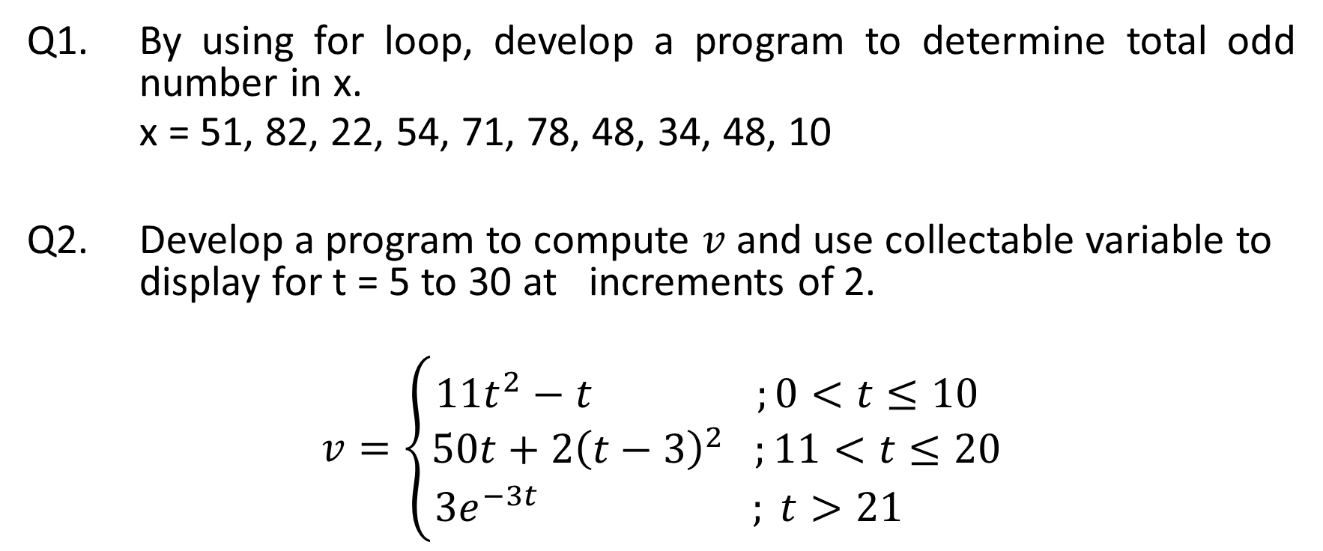
Answer on the following
Q1. By using for loop, develop a program to determine total odd number in x.
x = 51, 82, 22, 54, 71, 78, 48, 34, 48, 10
Q2. Develop a program to compute $v$ and use collectable variable to display for t = 5 to 30 at increments of 2.
$$v=\left\{\begin{aligned}11t^{2}−t ;0<t≤10 \\ 50t+2{\left(t−3\right)}^{2} ;11<t≤20 \\ 3e^{−3t} ; t>21 \end{aligned}\right.$$

Slide 19
End
https://forms.office.com/r/ysXvCQrS8E

